Slide 1
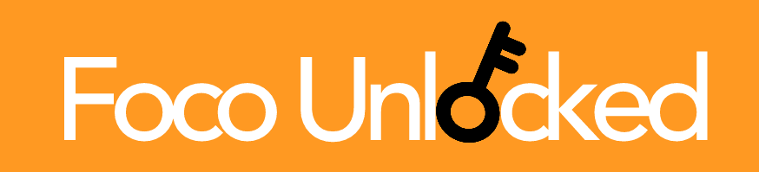
Foco Unlocked A mobile application for Foco diners to share their unique food combinations and find inspiration in others’ creations.
Madison Minsk ’19, Ijemma Onwuzulike ’19, Shirley Zhang ‘19

Slide 2
The Foco Problem
Foco has a large selection of food items, but this assortment remains largely stagnant from day to day and term to term
Students have developed ways of combining pre-made food items and ingredients, from pesto and chicken in the stir fry station, to Foco cookie sandwiches
We lack a platform for these students to connect and share their ideas with others

Slide 3
General Application Specifications
Two main pages:
An upload page- diners can add a photo of their meal with a short description of ingredients
The home page- displays the top food combinations of the day as determined by other diners up-voting combinations they like
Users can tap on the meal photos to leave a review or find out more information
Users will be ranked based upon how many up-votes their meals receive, enabling browsers to see a “top chef’s” popular meals

Slide 4
Stakeholders
All Foco diners will be able to browse and upload on the application, after making an account
Freshman vs. Upperclassman
Freshman can use the app to familiarize themselves with a brand new dining space, learning interesting food combinations and being inspired to try some of their own instead of relying solely on the pre-made meals.
Upperclassman can use the app to share the Foco knowledge they have built over their Dartmouth careers

Slide 5
Timeline
Design
March 5: Detailed final designs completed
Develop
March 23: Front end completed
April 4: Back-end completed
April 4-14: Conduct user testing
April 14: Consolidate user testing results, evaluation
Deliver
April 15: Presentation

Slide 6
Progress
Completed design phase
Finalized designs for each page of the application
Began front-end and back-end development

